Slide 1
Energy resources

Slide 2
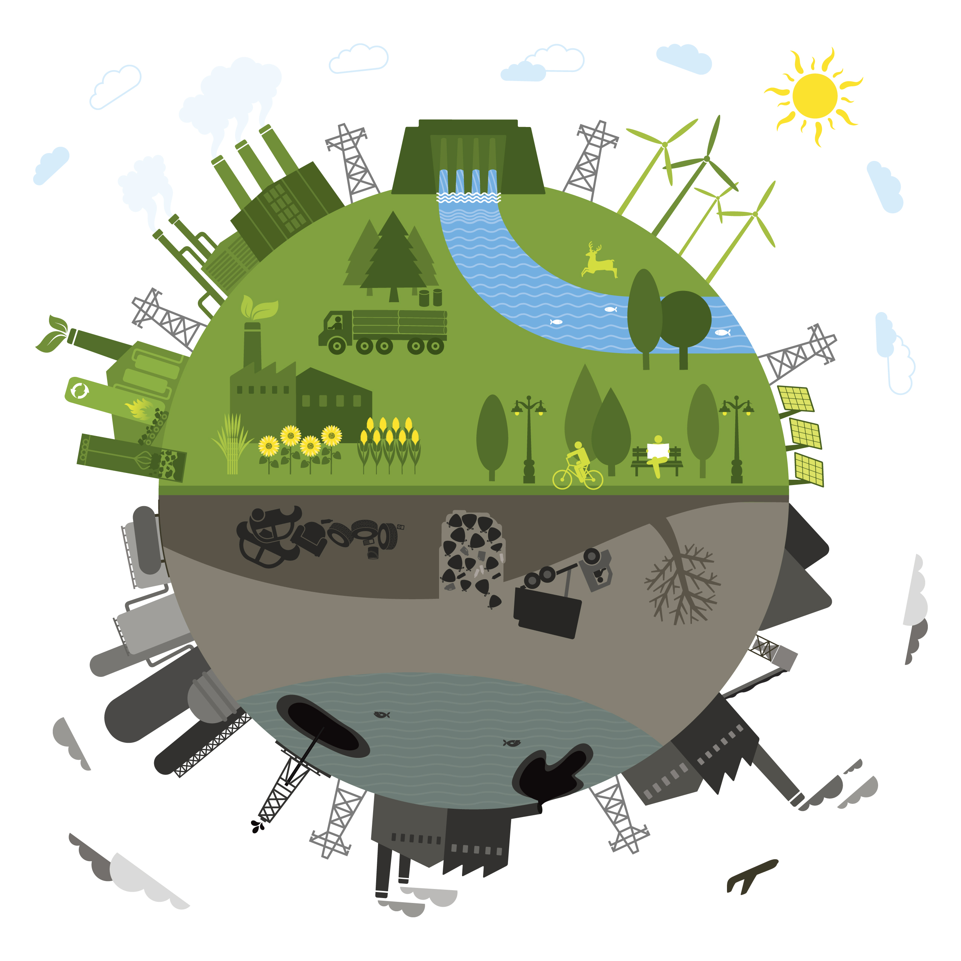
Energy resources
Produce heat
Produce electricity
Can be mined, harnessed, used

Slide 3
There are different types of energy resources:
nonrenewable
renewable
Coal
Oil
Natural gas
nuclear
Solar
Biomass
Hydroelectricity
Wind
Hydrogen
geothermal

Slide 4
nonrenewable
When its used, its gone
A new supply is not possible in a reasonable amount of time

Slide 5

Coal – solid fossil fuel
Nonrenewable
Easy to transport (move from place to place)
burns easily
Used by factories & electricity is generated for homes (like @ Plant Bowen)
Pollutes the air when burned which adds to the greenhouse effect due to the excessive CO2
Solid fossil fuel from the remains of dead swamp plants

Slide 6

Oil - liquid fossil fuel form of Petroleum
Nonrenewable
Produces large amounts of energy
Pollutes the air, adds to greenhouse effect due to excessive CO2
oil spills are a huge environmental issue
U.S. uses about 1/3 of ALL oil produced in the world, but we only have 3% of Earth’s oil supply in our country = expensive import when we need it, gas for cars comes from refined oil

Slide 7
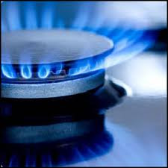
Natural Gas - gas fossil fuel
Nonrenewable
Used to heat homes & cook(blue flames on the stove top)
Burns a little cleaner than the other fossil fuels
Efficient energy source
Made of methane (a greenhouse gas)
can leak into the atmosphere & cause explosions
It is colorless, odorless & tasteless, so a chemical is added so it can be detected
Forms where coal & oil form

Slide 8
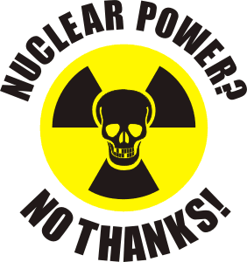
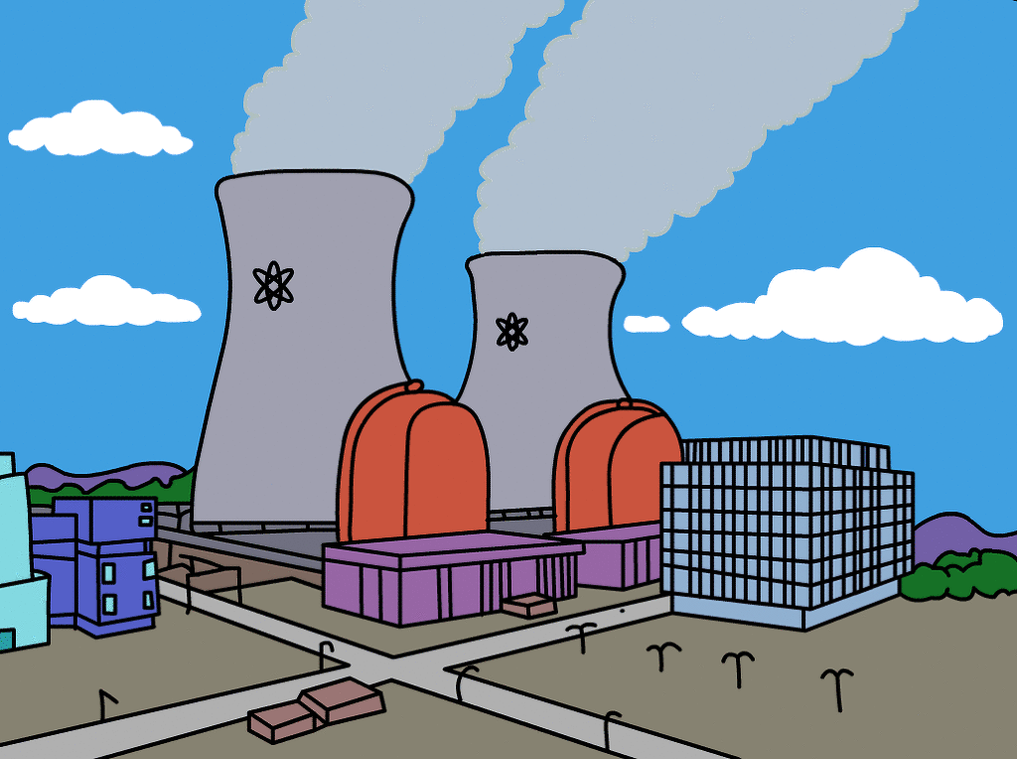
Nuclear - Atomic Energy
Nonrenewable
Produces huge amounts of energy
Produces radioactive wastes (toxic when something goes wrong!)
Requires mining of Uranium, which is dangerous
Chernobyl reactor meltdown caused environmental harm & dangers that are still a problem today

Slide 9
renewable
New supply is easily accessible
Always there & never runs out

Slide 10
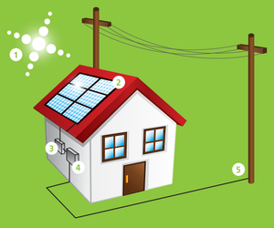
Solar - sun heats the atmosphere/area
Renewable
Does not pollute
Requires sunshine - doesn’t work @ night or on cloudy days
Expensive solar panels provide electricity
Passive solar heating: Heats up the inside of cars in parking lots & through windows = free heat ☺

Slide 11
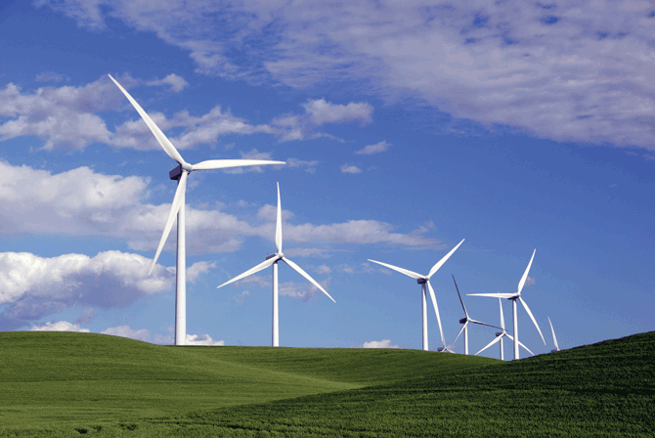
Wind - wind mills/wind farms
Renewable
No pollution
Requires strong and steady winds
Uses noisy generators
Fastest-growing energy source in the WORLD to generate electricity

Slide 12
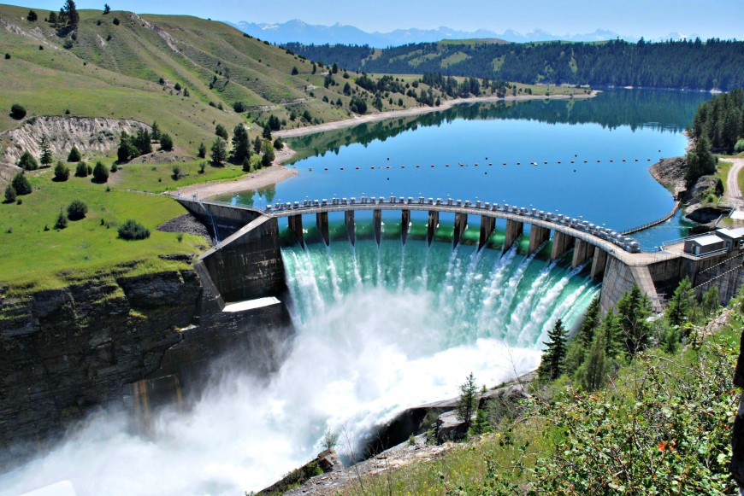
Hydroelectric - power plants @ dams
Renewable
No pollution
Dams can cause harm to the natural environment
requires HUGE flowing water source (not little creeks/streams)
Most widely-used renewable resource
Used to generate electricity for homes & buildings

Slide 13
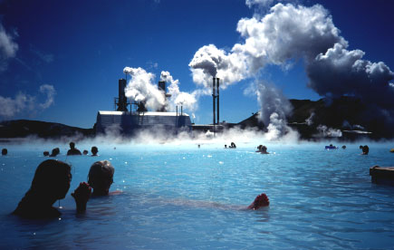
Geothermal - heat from within Earth
Renewable
No pollution
Limited availability (it’s not easy to get to everywhere)
Deep drilling can be EXPENSIVE
In Iceland, most homes are heated with geothermal energy

Slide 14
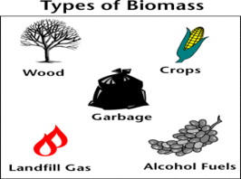
Biomass - Biofuels
Renewable
carbon neutral – doesn’t produce carbon emissions
Can be made into other fuels
Can be made from wood, sugar cane, corn, and other crops & garbage
Used to fuel cars
Produces methane gas when it decomposes (this gas traps heat in earth’s atmosphere, so too much is not a good thing)

Slide 15
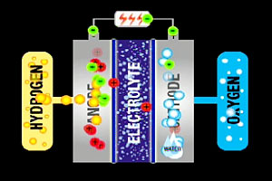
Hydrogen - uses fuel cell
Renewable
Burn cleanly
No pollution
Possible new method to fuel cars
Inefficient right now: Takes more energy to burn the hydrogen than it will produce when its burned

Slide 16
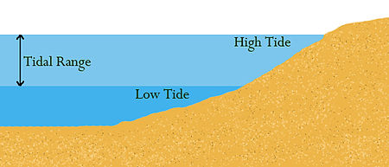
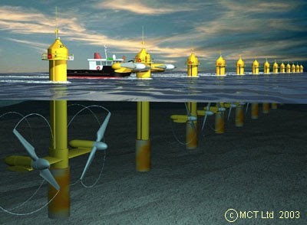
Tidal
Renewable
Consistent & Predictable
Efficient at low speeds
Low cost to run for a long time
Expensive construction
Long distances to the areas needing power
Possible damage from storms
Construction & maintenance challenges
Converts the energy from water movement during tides to electricity

Slide 17
Energy Conservation is the practice of using less energy.
Examples: turn off lights when you leave a room, turn off TV (etc) when you’re not watching it, turn your thermostat in your house to 68 in the winter & 78 in the summer to control the temperature, wash laundry in cold water to limit water heater use, carpool to conserve fossil fuels, insulate your house better to keep heat in & cold out (or vice versa), replace incandescent light bulbs with compact fluorescent lamps (the curly ones) or LED, unplug appliances that are not being used…can you think of others?

Slide 18


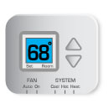

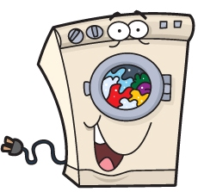
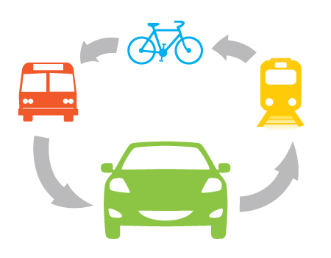
Conservation
Ideas

Slide 19
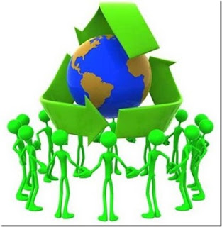
Help take care of our planet earth!
Recycle, reduce, reuse!

